Slide 1
गरीब कल्याण रोजगार अभियान

Slide 2
ग़रीब कल्याण रोजगार अभियान
Duration – 125 Days
116 Districts with more than 25,000 migrants
Employment and infrastructure creation – 25 works
Outlay of Rs. 50,000 crores

Slide 3
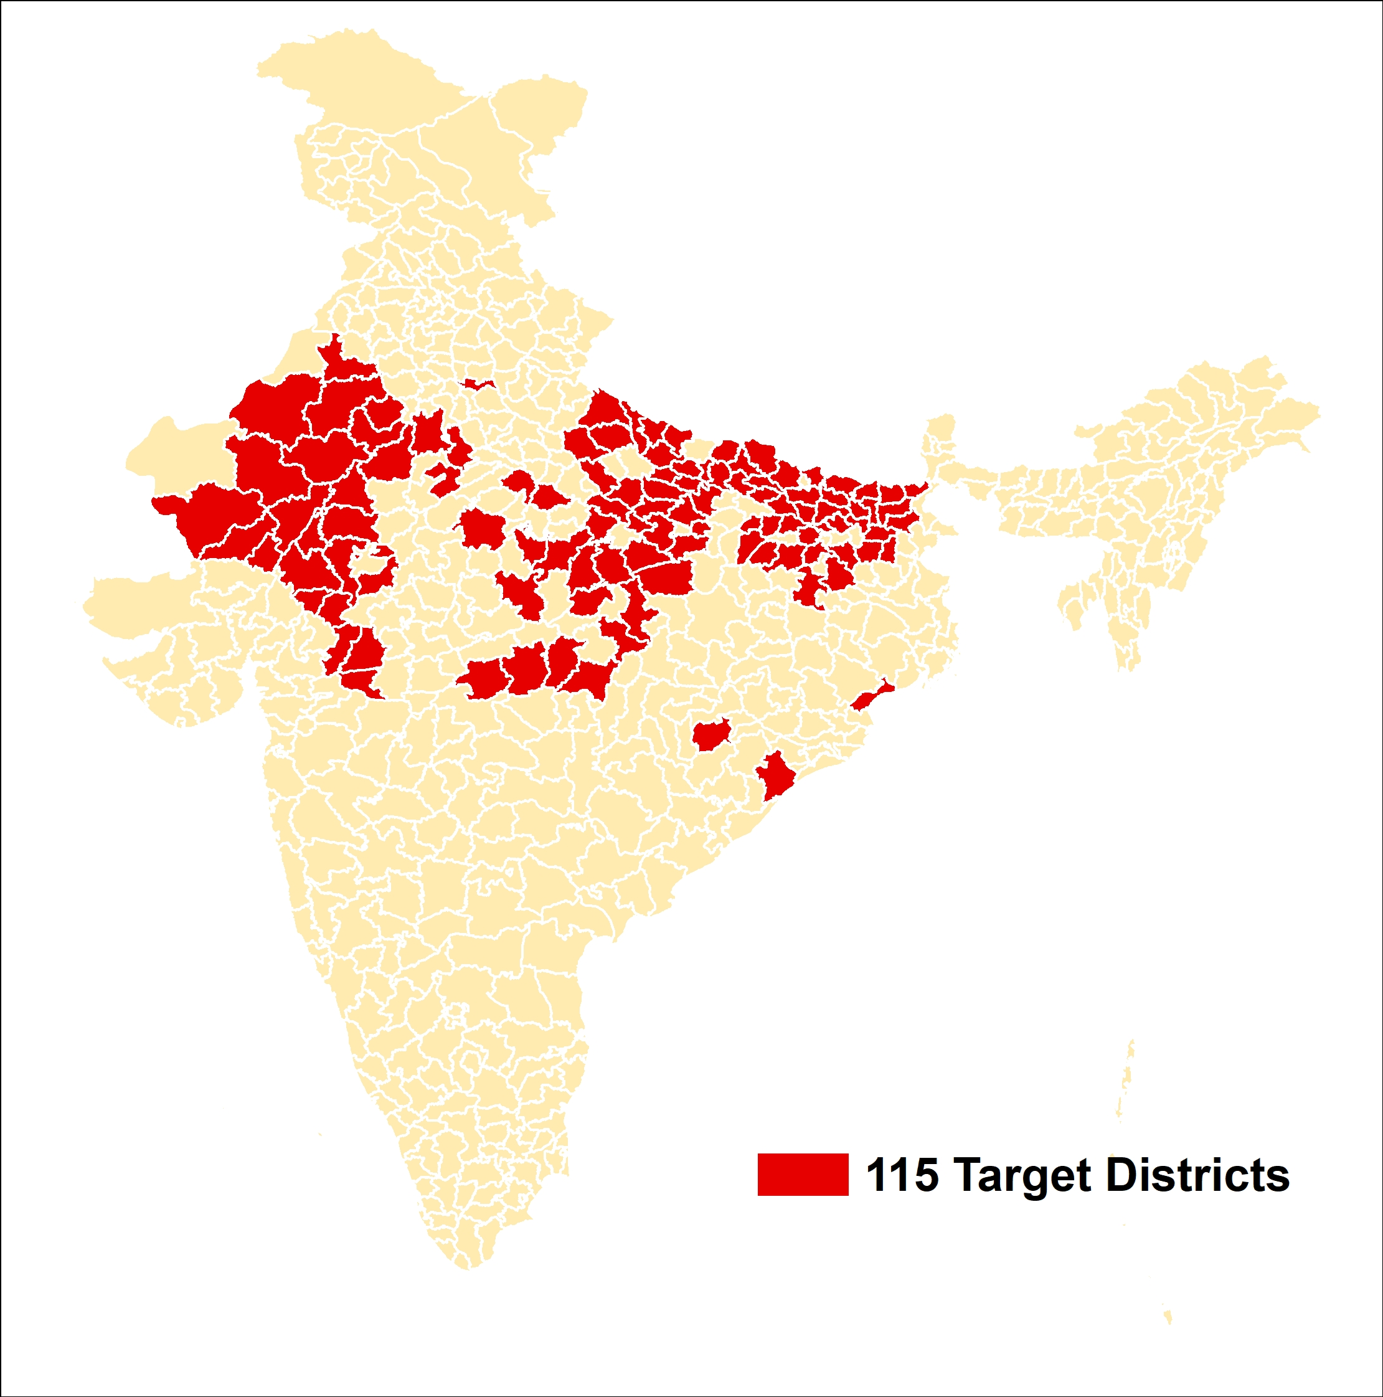
116 Districts account for ~67 Lakh migrant workers (approx. 2/3 of returnee migrants)
S.No. | State Name | Districts | Aspirational Districts
1 | Bihar | 32 | 12
2 | Uttar Pradesh | 31 | 5
3 | Madhya Pradesh | 24 | 4
4 | Rajasthan | 22 | 2
5 | Odisha | 4 | 1
6 | Jharkhand | 3 | 3
 | Total Districts | 116 | 27
115 Target districts
116 Target Districts

Slide 4
Focus on 25 works
1
Community sanitation complex
2
Gram Panchayat Bhawan
3
Works under Finance Commission funds
4
National Highway works
5
Water conservation & Harvesting works
6
Construction of Wells
7
Plantation (including through CAMPA Funds)
8
Horticulture

Slide 5
Focus on 25 works
9
Anganwadi Centers
10
Rural Housing (PMAY – Gramin)
11
Rural connectivity (PMGSY) & Border road works
12
Railway works
13
Shyama Prasad Mukherjee RURBAN Mission
14
PM KUSUM works
15
Laying of Fiber Optic Cable under Bharat Net
16
Works under Jal Jeevan Mission

Slide 6
Focus on 25 works
17
Works under PM Urja Ganga Project
18
Training through KVKs for Livelihoods
19
Works through District Mineral Fund
20
Solid and Liquid waste management works
21
Farm ponds
22
Cattle sheds
23
Goat Sheds
24
Poultry sheds
25
Vermicomposting

Slide 7
Launch by Hon. PM on Saturday, 20th June at 11 am
District – खगड़िया (बिहार)
Block – बेलदौर
Village – तेलिहार
Location – Panchayat Bhavan

Slide 8
THANK YOU

Slide 9
Annexure: List of districts (1/2)
# | State | District
1 | Bihar | East Champaran
2 | Bihar | Katihar
3 | Bihar | Madhubani
4 | Bihar | Gaya
5 | Bihar | West Champaran
6 | Bihar | Darbhanga
7 | Bihar | Araria
8 | Bihar | Muzaffarpur
9 | Bihar | Purnia
10 | Bihar | Saran
11 | Bihar | Rohtas
12 | Bihar | Samatipur
13 | Bihar | Banka
14 | Bihar | Khagaria
15 | Bihar | Begusarai
16 | Bihar | Supaul
17 | Bihar | Bhagalpur
18 | Bihar | Saharsa
19 | Bihar | Aurangabad
20 | Bihar | Buxar
21 | Bihar | Vaishali
22 | Bihar | Kishanganj
23 | Bihar | Madhepura
24 | Bihar | Sitamarhi
25 | Bihar | Bhojpur
26 | Bihar | Siwan
27 | Bihar | Patna
28 | Bihar | Nalanda
29 | Bihar | Gopalganj
30 | Bihar | Jamui
# | State | District
31 | Bihar | Nawada
32 | Bihar | Kaimur
33 | Jharkhand | Giridih
34 | Jharkhand | Hazaribagh
35 | Jharkhand | Godda
36 | Odisha | Ganjam
37 | Odisha | Balasore
38 | Odisha | Bolangir
39 | Odisha | Bhadrak
40 | Madhya Pradesh | BALAGHAT
41 | Madhya Pradesh | JHABUA
42 | Madhya Pradesh | TIKAMGARH
43 | Madhya Pradesh | CHHATARPUR
44 | Madhya Pradesh | REWA
45 | Madhya Pradesh | SATNA
46 | Madhya Pradesh | SAGAR
47 | Madhya Pradesh | PANNA
48 | Madhya Pradesh | BHIND
49 | Madhya Pradesh | ALIRAJPUR
50 | Madhya Pradesh | BETUL
51 | Madhya Pradesh | KHANDWA
52 | Madhya Pradesh | SHAHDOL
53 | Madhya Pradesh | DHAR
54 | Madhya Pradesh | DINDORI
55 | Madhya Pradesh | KATNI
56 | Madhya Pradesh | CHHINDWARA
57 | Madhya Pradesh | SEONI
58 | Madhya Pradesh | MANDLA
59 | Madhya Pradesh | KHARGONE
60 | Madhya Pradesh | SHIVPURI

Slide 10
Annexure: List of districts (2/2)
# | State | District
61 | Madhya Pradesh | BARWANI
62 | Madhya Pradesh | SIDHI
63 | Madhya Pradesh | SINGRAULI
64 | Uttar Pradesh | Siddharth Nagar
65 | Uttar Pradesh | Prayagraj
66 | Uttar Pradesh | Gonda
67 | Uttar Pradesh | Maharajganj
68 | Uttar Pradesh | Bahraich
69 | Uttar Pradesh | Balrampur
70 | Uttar Pradesh | Jaunpur
71 | Uttar Pradesh | Hardoi
72 | Uttar Pradesh | Azamgarh
73 | Uttar Pradesh | Basti
74 | Uttar Pradesh | Gorakhpur
75 | Uttar Pradesh | Sultanpur
76 | Uttar Pradesh | Kushi Nagar
77 | Uttar Pradesh | Sant Kabir Nagar
78 | Uttar Pradesh | Banda
79 | Uttar Pradesh | Ambedkar Nagar
80 | Uttar Pradesh | Sitapur
81 | Uttar Pradesh | Varanasi
82 | Uttar Pradesh | Ghazipur
83 | Uttar Pradesh | Pratapgarh
84 | Uttar Pradesh | Rae Bareli
85 | Uttar Pradesh | Ayodhya
86 | Uttar Pradesh | Deoria
87 | Uttar Pradesh | Amethi
88 | Uttar Pradesh | Lakhimpur Kheri
89 | Uttar Pradesh | Unnao
90 | Uttar Pradesh | Shrawasti
# | State | District
91 | Uttar Pradesh | Fatehpur
92 | Uttar Pradesh | Mirzapur
93 | Uttar Pradesh | Jalaun
94 | Uttar Pradesh | Kaushambi
95 | Rajasthan | PALI
96 | Rajasthan | UDAIPUR
97 | Rajasthan | JALORE
98 | Rajasthan | NAGAUR
99 | Rajasthan | SIROHI
100 | Rajasthan | DUNGARPUR
101 | Rajasthan | SIKAR
102 | Rajasthan | RAJSAMAND
103 | Rajasthan | BARMER
104 | Rajasthan | CHITTORGARH
105 | Rajasthan | ALWAR
106 | Rajasthan | KARAULI
107 | Rajasthan | BIKANER
108 | Rajasthan | JODHPUR
109 | Rajasthan | BHILWARA
110 | Rajasthan | BHARATPUR
111 | Rajasthan | BANSWARA
112 | Rajasthan | AJMER
113 | Rajasthan | HANUMANGARH
114 | Rajasthan | CHURU
115 | Rajasthan | JHUNJHUNU
116 | Rajasthan | JAIPUR

