Slide 1
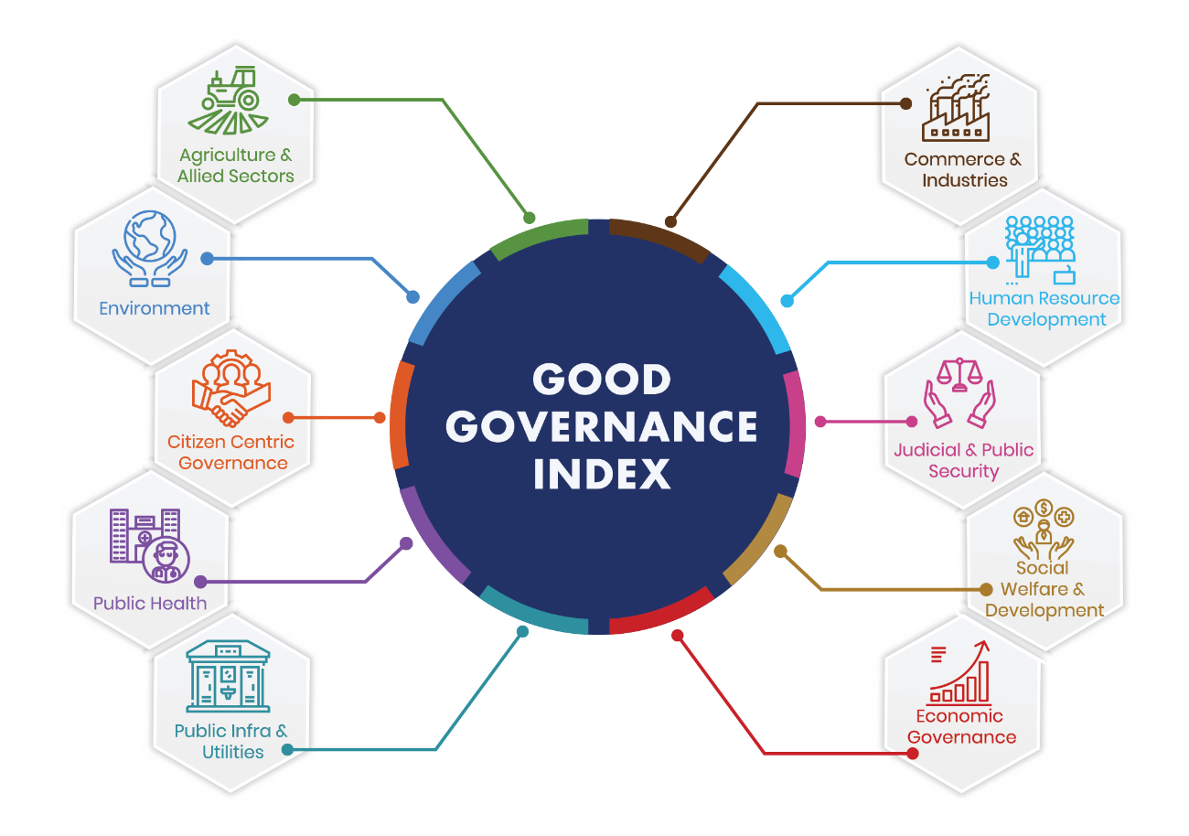
Good Governance Day – 25 December 2019

Slide 2
Good Governance Index (GGI)
A uniform tool across States to assess the Status of Governance and impact of various interventions taken up by the State Government and Union Territories (UTs).
Objectives of GGI
Provide quantifiable data to compare the State of Governance in the States and UTs
Enable States and UTs to formulate and implement suitable strategies for improving governance
Shift to result oriented approaches and administration

Slide 3
Good Governance Index (GGI) - Background
Conceptualization
Concept Presentation to Sectoral Group of Secretaries 9 on Governance in 2017– Recommended to Develop GGI
Project Initiation
Initiation Meeting
Literature Review followed by National and State Consultations
CGG, Hyderabad as Technical Partner
DARPG advised to Develop GGI

Slide 4
Indicator Selection Principles
Simple & Measurable
Easy to understand & calculate
Output & Outcome
Citizen centric & result driven
Applicability Across the States
Applicable to All States and UTs
Availability of Database
State-wise Time-series & authentic
Input &
process
Compile data at Ministry level
Leading to improved results
Data generation

Slide 5
Stakeholders’ Consultation
National Consultations with Sector Experts: SDG, Finance, Environment, Governance, etc.
DARPG & CGG Expert Team (4 May 2017)
Consultation with the States & UTs
ATI, Nainital: Northern States (07 - 08 July 2017)
CGG, Hyderabad: 22 States (22 July 2017)
GIPARD, Goa: 17 States (14 - 15 Sept 2017)
ATI, Guwahati: (22 – 23 Dec 2017)
Consultation Meetings with Ministries of GoI
three rounds of inter-ministerial consultations at Delhi (01-02 June, 08 June & 15-16 June 2017)
Presentation to
Sectoral Group of Secretaries (SGoS-9)
(2 June 2017 & 14 August 2017)

Slide 6
GGI Report Finalisation
Draft GGI report was finalised by DARPG and circulated on 06 Nov 2018 to all Ministries/Departments and States and UTs for feedback/input
Response received from 17 Ministries/Departments, 3 States and one Union Territory

Slide 7
GGI Sectors & Indicators
# | Governance Sectors | No of Indicators | # | Governance Sectors | No of Indicators
1. | Agriculture and Allied Sectors | 6 | 6. | Economic Governance | 4
2. | Commerce & Industries | 3 | 7. | Social Welfare & Development | 8
3. | Human Resource Development | 6 | 8. | Judicial & Public Security | 5
4. | Public Health | 6 | 9. | Environment | 2
5. | Public Infrastructure & Utilities | 9 | 10. | Citizen Centric Governance | 1
 |  |  |  | Total | 50

Slide 8
Grouping of States
# | Big States | # | North East and Hill States | # | Union Territories*
1. | Andhra Pradesh | 1. | Arunachal Pradesh | 1. | A&N Islands
2. | Bihar | 2. | Assam | 2. | Chandigarh
3. | Chhattisgarh | 3. | Himachal Pradesh | 3. | D&N Haveli
4. | Goa | 4. | J & K* | 4. | Daman & Diu
5. | Gujarat | 5. | Manipur | 5. | Delhi
6. | Haryana | 6. | Meghalaya | 6. | Lakshadweep
7. | Jharkhand | 7. | Mizoram | 7. | Pondicherry
8. | Karnataka | 8. | Nagaland |  | Note: * = The State of Jammu & Kashmir (J&K) and Ladakh are accorded the status of UTs recently. While designing the GGI framework and subsequent ranking the data was available for J&K as State and no data was available separately for Ladakh. Therefore, J&K is included under the North East and Hills Category and Ladakh as UT is not part of raking. The subsequent edition of GGI may include J& K and Ladakh in the respective category based on their newly accorded status.
9. | Kerala | 9. | Sikkim
10. | Madhya Pradesh | 10. | Tripura
11. | Maharashtra | 11. | Uttarakhand
12. | Orissa
13. | Punjab
14. | Rajasthan
15. | Tamil Nadu
6. | Telangana
17. | Uttar Pradesh
18. | West Bengal

Slide 9
Rankings

Slide 10
Agriculture & Allied Sector
# | Indicators | Weightage
1 | Growth Rate of Agriculture and Allied Sector | 0.4
2 | Growth Rate of Food Grains Production | 0.1
3 | Growth Rate of Horticulture Produce | 0.1
4 | Growth Rate of Milk Production | 0.1
5 | Growth Rate of Meat Production | 0.1
6 | Crop Insurance | 0.2

Slide 11
Agriculture & Allied Ranking
# | Big States | Score | NE & Hill | Score | UTs | Score
1 | Madhya Pradesh | 0.73 | Mizoram | 0.66 | Daman & Diu | 0.51
2 | Rajasthan | 0.60 | Himachal Pradesh | 0.47 | Pondicherry | 0.45
3 | Chhattisgarh | 0.58 | Tripura | 0.44 | A&N Islands | 0.38
4 | Bihar | 0.50 | J & K | 0.44 | Chandigarh | 0.32
5 | Haryana | 0.48 | Meghalaya | 0.43 | Lakshadweep | 0.25
6 | Andhra Pradesh | 0.48 | Assam | 0.41 | D&N Haveli | 0.23
7 | Uttar Pradesh | 0.45 | Uttarakhand | 0.38 | Delhi | 0.17
8 | West Bengal | 0.45 | Sikkim | 0.33
9 | Tamil Nadu | 0.45 | Arunachal Pradesh | 0.30
10 | Orissa | 0.44 | Manipur | 0.29
11 | Gujarat | 0.44 | Nagaland | 0.29
12 | Karnataka | 0.43
13 | Maharashtra | 0.42
14 | Jharkhand | 0.41
15 | Punjab | 0.35
16 | Kerala | 0.30
17 | Telangana | 0.29
18 | Goa | 0.29

Slide 12
Commerce and Industries
# | Indicators | Weightage
1 | Ease-of-Doing-Business (EoDB) | 0.9
2 | Growth Rate of Industries | 0.05
3 | Micro, Small and Medium Enterprises (MSME) Establishments | 0.05

Slide 13
Commerce & Industries Ranking
# | Big States | Score | NE & Hill | Score | UTs | Score
1 | Jharkhand | 0.94 | Uttarakhand | 0.91 | Delhi | 0.33
2 | Andhra Pradesh | 0.94 | Himachal Pradesh | 0.83 | Daman & Diu | 0.30
3 | Telangana | 0.93 | Assam | 0.83 | D&N Haveli | 0.22
4 | Chhattisgarh | 0.93 | J & K | 0.34 | Pondicherry | 0.20
5 | Gujarat | 0.92 | Tripura | 0.28 | Chandigarh | 0.12
6 | Haryana | 0.92 | Nagaland | 0.19 | A&N Islands | 0.04
7 | West Bengal | 0.92 | Mizoram | 0.06 | Lakshadweep | 0.02
8 | Madhya Pradesh | 0.92 | Sikkim | 0.06
9 | Karnataka | 0.91 | Arunachal Pradesh | 0.05
10 | Rajasthan | 0.90 | Meghalaya | 0.04
11 | Maharashtra | 0.90 | Manipur | 0.04
12 | Uttar Pradesh | 0.89
13 | Orissa | 0.87
14 | Tamil Nadu | 0.86
15 | Bihar | 0.82
16 | Goa | 0.54
17 | Punjab | 0.51
18 | Kerala | 0.43

Slide 14
Human Resource Development
# | Indicators | Weightage
1 | Quality of Education | 0.3
2 | Gender Parity Index | 0.2
3 | Retention Rate at Elementary Level (Grade I to VIII) | 0.2
4 | Enrolment ratio of SC and ST | 0.1
5 | Skill trainings imparted | 0.1
6 | Placement ratio including self-employment* | 0.1

Slide 15
Human Resource Development Ranking
# | Big States | Score | NE & Hill | Score | UTs | Score
1 | Goa | 0.81 | Himachal Pradesh | 0.74 | Pondicherry | 0.85
2 | Punjab | 0.80 | Uttarakhand | 0.62 | Delhi | 0.78
3 | Haryana | 0.78 | Manipur | 0.54 | Daman & Diu | 0.74
4 | Kerala | 0.76 | Tripura | 0.50 | Chandigarh | 0.73
5 | Tamil Nadu | 0.64 | J & K | 0.50 | A&N Islands | 0.58
6 | Maharashtra | 0.62 | Nagaland | 0.47 | D&N Haveli | 0.52
7 | Gujarat | 0.61 | Assam | 0.46 | Lakshadweep | 0.33
8 | Uttar Pradesh | 0.61 | Mizoram | 0.42
9 | Andhra Pradesh | 0.58 | Sikkim | 0.42
10 | Bihar | 0.58 | Meghalaya | 0.40
11 | Telangana | 0.55 | Arunachal Pradesh | 0.30
12 | Orissa | 0.55
13 | Karnataka | 0.54
14 | Chhattisgarh | 0.51
15 | Rajasthan | 0.48
16 | West Bengal | 0.46
17 | Madhya Pradesh | 0.41
18 | Jharkhand | 0.39

Slide 16
Public Health
# | Indicators | Weightages
1 | Infant Mortality Rate (IMR) | 0.3
2 | Maternal Mortality Ratio (MMR) | 0.3
3 | Total Fertility Rate (TFR) | 0.1
4 | Immunization Achievement | 0.1
5 | Availability of Doctors and Paramedical Staff at PHCs | 0.1
6 | Operationalization of 24X7 Facility at PHCs | 0.1

Slide 17
Public Health Ranking
# | Big States | Score | NE & Hill | Score | UTs | Score
1 | Kerala | 0.81 | Manipur | 0.80 | Pondicherry | 0.75
2 | Tamil Nadu | 0.78 | Sikkim | 0.72 | A&N Islands | 0.75
3 | Goa | 0.77 | Mizoram | 0.67 | Chandigarh | 0.75
4 | Maharashtra | 0.74 | Nagaland | 0.65 | Lakshadweep | 0.73
5 | Punjab | 0.63 | Tripura | 0.62 | Delhi | 0.68
6 | West Bengal | 0.63 | Himachal Pradesh | 0.58 | Daman & Diu | 0.61
7 | Andhra Pradesh | 0.63 | J & K | 0.57 | D&N Haveli | 0.52
8 | Telangana | 0.63 | Meghalaya | 0.40
9 | Karnataka | 0.59 | Uttarakhand | 0.38
10 | Haryana | 0.56 | Arunachal Pradesh | 0.28
11 | Gujarat | 0.53 | Assam | 0.28
12 | Jharkhand | 0.44
13 | Bihar | 0.36
14 | Chhattisgarh | 0.32
15 | Rajasthan | 0.32
16 | Orissa | 0.30
17 | Madhya Pradesh | 0.27
18 | Uttar Pradesh | 0.18

Slide 18
Public Infrastructure & Utilities
# | Indicators | Weightage
1 | Access to Potable Water | 0.25
2 | Towns declared Open Defecation Free (ODF) | 0.10
3 | Village declared ODF | 0.10
4 | Connectivity to Rural Habitations | 0.10
5 | Access to Clean Cooking Fuel (LPG / PNG) | 0.10
6 | Access to Power Supply | 0.05
7 | Availability of 24X7 Power Supply | 0.05
8 | Energy Availability against the Requirement | 0.05
9 | Growth in Per Capita Power Consumption | 0.20

Slide 19
Public Infrastructure Ranking
# | Big States | Score | NE & Hill | Score | UTs | Score
1 | Tamil Nadu | 0.74 | Himachal Pradesh | 0.64 | Chandigarh | 0.84
2 | Gujarat | 0.73 | Uttarakhand | 0.64 | Delhi | 0.72
3 | Punjab | 0.73 | Tripura | 0.57 | Pondicherry | 0.69
4 | Maharashtra | 0.73 | Mizoram | 0.56 | Daman & Diu | 0.67
5 | Haryana | 0.71 | J & K | 0.55 | A&N Islands | 0.58
6 | Telangana | 0.70 | Meghalaya | 0.53 | D&N Haveli | 0.56
7 | Goa | 0.68 | Manipur | 0.53 | Lakshadweep | 0.54
8 | Andhra Pradesh | 0.66 | Sikkim | 0.51
9 | Kerala | 0.66 | Assam | 0.49
10 | Karnataka | 0.64 | Nagaland | 0.48
11 | Uttar Pradesh | 0.59 | Arunachal Pradesh | 0.38
12 | Madhya Pradesh | 0.58
13 | Bihar | 0.57
14 | Rajasthan | 0.57
15 | West Bengal | 0.54
16 | Jharkhand | 0.53
17 | Chhattisgarh | 0.51
18 | Orissa | 0.50

Slide 20
Economic Governance
# | Indicators | Weightage
1 | Growth in per Capita Gross State Domestic Product (GSDP) | 0.30
2 | Fiscal Deficit as a percentage of GSDP | 0.10
3 | State’s Own Tax Revenue Receipts to Total Revenue Receipts | 0.30
4 | Debt (Total Outstanding Liabilities) to GSDP | 0.30

Slide 21
Economic Governance Ranking
# | Big States | Score | NE & Hill | Score | UTs | Score
1 | Karnataka | 0.68 | Uttarakhand | 0.60 | Delhi | 0.83
2 | Maharashtra | 0.66 | Tripura | 0.55 | A&N Islands | 0.42
3 | Telangana | 0.63 | Assam | 0.55 | Chandigarh | 0.38
4 | Gujarat | 0.62 | Himachal Pradesh | 0.45 | Pondicherry | 0.19
5 | Tamil Nadu | 0.58 | Manipur | 0.42 | D&N Haveli | Not Part of Ranking due to Data Unavailability
6 | Chhattisgarh | 0.55 | Sikkim | 0.42 | Daman & Diu
7 | Andhra Pradesh | 0.55 | Mizoram | 0.39 | Lakshadweep
8 | Haryana | 0.54 | Arunachal Pradesh | 0.39
9 | Orissa | 0.53 | Meghalaya | 0.29
10 | Bihar | 0.52 | J & K | 0.26
11 | Madhya Pradesh | 0.52 | Nagaland | 0.21
12 | West Bengal | 0.49
13 | Goa | 0.47
14 | Uttar Pradesh | 0.47
15 | Kerala | 0.46
16 | Rajasthan | 0.44
17 | Jharkhand | 0.39
18 | Punjab | 0.37

Slide 22
Social Welfare & Development
# | Indicators | Weightage
1 | Sex Ratio at Birth | 0.1
2 | Health Insurance Coverage | 0.1
3 | Rural Employment Guarantee | 0.2
4 | Unemployment Rate | 0.2
5 | Housing for All | 0.1
6 | Economic Empowerment of Women | 0.1
7 | Empowerment of SCs, OBCs and Minorities | 0.1
8 | Disposal of SC-ST Atrocity Cases by Courts | 0.1

Slide 23
Social Welfare & Development Ranking
# | Big States | Score | NE & Hill | Score | UTs | Score
1 | Chhattisgarh | 0.65 | Meghalaya | 0.74 | Daman & Diu | 0.55
2 | Madhya Pradesh | 0.60 | Sikkim | 0.65 | D&N Haveli | 0.49
3 | Andhra Pradesh | 0.57 | Mizoram | 0.59 | A&N Islands | 0.33
4 | West Bengal | 0.56 | Tripura | 0.49 | Chandigarh | 0.29
5 | Rajasthan | 0.51 | Himachal Pradesh | 0.48 | Pondicherry | 0.27
6 | Orissa | 0.51 | J & K | 0.46 | Delhi | 0.23
7 | Tamil Nadu | 0.49 | Arunachal Pradesh | 0.43 | Lakshadweep | 0.21
8 | Telangana | 0.46 | Uttarakhand | 0.38
9 | Kerala | 0.45 | Assam | 0.34
10 | Karnataka | 0.45 | Manipur | 0.27
11 | Maharashtra | 0.42 | Nagaland | 0.17
12 | Gujarat | 0.41
13 | Jharkhand | 0.38
14 | Punjab | 0.36
15 | Uttar Pradesh | 0.35
16 | Bihar | 0.32
17 | Goa | 0.28
18 | Haryana | 0.28

Slide 24
Judiciary & Public Security
# | Indicators | Weightage
1 | Conviction Rate | 0.30
2 | Availability of Police Personnel | 0.25
3 | Proportion of Women Police Personnel | 0.15
4 | Disposal of Court Cases | 0.15
5 | Disposal of cases by consumer courts | 0.15

Slide 25
Judicial & Public Security Ranking
# | Big States | Score | NE & Hill | Score | UTs | Score
1 | Tamil Nadu | 0.56 | Himachal Pradesh | 0.54 | Pondicherry | 0.70
2 | Kerala | 0.55 | Nagaland | 0.52 | Chandigarh | 0.63
3 | Chhattisgarh | 0.50 | Mizoram | 0.50 | A&N Islands | 0.48
4 | Rajasthan | 0.49 | Sikkim | 0.48 | Delhi | 0.47
5 | Maharashtra | 0.40 | Uttarakhand | 0.47 | D&N Haveli | 0.38
6 | Madhya Pradesh | 0.37 | Tripura | 0.47 | Lakshadweep | 0.34
7 | Karnataka | 0.36 | Manipur | 0.46 | Daman & Diu | 0.27
8 | Goa | 0.34 | Meghalaya | 0.40
9 | Andhra Pradesh | 0.30 | J & K | 0.35
10 | Punjab | 0.30 | Arunachal Pradesh | 0.32
11 | Gujarat | 0.30 | Assam | 0.20
12 | Haryana | 0.26
13 | Orissa | 0.25
14 | Jharkhand | 0.25
15 | Uttar Pradesh | 0.23
16 | Telangana | 0.22
17 | West Bengal | 0.21
18 | Bihar | 0.19

Slide 26
Environment
# | Indicators | Weightage
1 | Availability of State-level Action Plan for Climate Change | 0.4
2 | Change in Forest Cover | 0.6

Slide 27
Environment Ranking
# | Big States | Score | NE & Hill | Score | UTs | Score
1 | West Bengal | 0.63 | Himachal Pradesh | 5.22 | Chandigarh | 0.62
2 | Kerala | 0.59 | Uttarakhand | 4.87 | Daman & Diu | 0.60
3 | Tamil Nadu | 0.58 | Tripura | 4.50 | Pondicherry | 0.56
4 | Bihar | 0.56 | Mizoram | 4.41 | A&N Islands | 0.54
5 | Orissa | 0.56 | Sikkim | 4.21 | Lakshadweep | 0.54
6 | Punjab | 0.55 | Assam | 4.07 | Delhi | 0.17
7 | Karnataka | 0.55 | J & K | 4.04 | D&N Haveli | 0.14
8 | Rajasthan | 0.55 | Manipur | 3.93
9 | Jharkhand | 0.55 | Meghalaya | 3.81
10 | Uttar Pradesh | 0.55 | Nagaland | 3.55
11 | Gujarat | 0.55 | Arunachal Pradesh | 3.03
12 | Maharashtra | 0.54
13 | Chhattisgarh | 0.54
14 | Madhya Pradesh | 0.54
15 | Haryana | 0.54
16 | Telangana | 0.49
17 | Andhra Pradesh | 0.40
18 | Goa | 0.14

Slide 28
Composite Ranking

Slide 29
Composite Ranking
# | Big States | Score | NE & Hill | Score | UTs | Score
1 | Tamil Nadu | 5.62 | Himachal Pradesh | 5.22 | Pondicherry | 4.69
2 | Maharashtra | 5.40 | Uttarakhand | 4.87 | Chandigarh | 4.68
3 | Karnataka | 5.10 | Tripura | 4.50 | Delhi | 4.39
4 | Chhattisgarh | 5.05 | Mizoram | 4.41 | Daman & Diu | 4.33
5 | Andhra Pradesh | 5.05 | Sikkim | 4.21 | A&N Islands | 4.12
6 | Gujarat | 5.04 | Assam | 4.07 | D&N Haveli | 3.12
7 | Haryana | 5.00 | J & K | 4.04 | Lakshadweep | 2.97
8 | Kerala | 4.98 | Manipur | 3.93
9 | Madhya Pradesh | 4.85 | Meghalaya | 3.81
10 | West Bengal | 4.84 | Nagaland | 3.55
11 | Telangana | 4.83 | Arunachal Pradesh | 3.03
12 | Rajasthan | 4.80
13 | Punjab | 4.57
14 | Orissa | 4.44
15 | Bihar | 4.40
16 | Goa | 4.29
17 | Uttar Pradesh | 4.25
18 | Jharkhand | 4.23

Slide 30
Thank You

